Slide 1





Graduation
& Beyond
Parent Presentation for the
Class of 2027
Information and Tips for Creating a Successful High School
& Career Experience
Notes:
1

Slide 2
TOPICS
Clicking on topic takes you to start of the section:
Athletics
BRIDGE Law
Core Courses
Definitions Regarding High School
Dual Enrollment
Financial Aid Resources
GAfutures
Graduation Requirements
Honors and Advanced Placement
MYAP Tool, Individual Graduation Plan
Pathways-Advanced Academic, CTAE, Fine Arts, World Language
Paulding Virtual Academy
PCCA-Paulding College and Career Academy

Slide 3
The Georgia Graduation Rule for the Class of 2012 and Thereafter
Began with the 2007-2008 Freshman Class
Changes were made to the former graduation rule to adhere to the Georgia Performance Standards and the American Diploma Project
For parents/guardians with older students, the Old System had 4 tiers
1) College Prep,
2) College Prep w/ distinction,
3) Technology & Career
4) Technology & Career w/ distinction
The Current Rule has 1 set of requirements
Objective: All High School Graduates will be prepared for College and the Workplace.
Notes:
3

Slide 4
Some Definitions
Approved Courses: Approved courses are courses based on the concepts and skills included in the state-adopted curriculum for grades 9-12 and approved by the Georgia Department of Education for equivalency credit and funding.
College and Career Readiness: the level of achievement/skills required in order for a student to enroll and have success in a post- secondary institution, the world of work, and/or the military.
Course: A course is instruction for which credit is awarded.
Credit: Carnegie units earned and applied to high school graduation and credit hours earned toward the completion of a postsecondary program of study.
1 90-Minute Class equals 1 Credit = BLOCK Course
Notes:
4

Slide 5
Some More Definitions
Pathway: a plan of study in sequential courses with an Area of Focus:
  Career, Technical and Agricultural Education Area of Focus: sequence of 3 rigorous courses within a defined pathway
  Advanced Academic Area of Focus: a sequence of three rigorous courses in English, Mathematics, Science, or Social Studies
  World Language/Latin Area of Focus: a sequence of three rigorous world language courses with a defined pathway
  Fine Arts Area of Focus: a sequence of three rigorous Fine Arts courses with a defined pathway
Notes:
5

Slide 6
The BRIDGE Advisement Law
(Mandated Advisement Signed into Law in May 2010 and has been updated several times since then)

Slide 7

BRIDGE Law Mandated Advisement
Requirements for Middle School
The following BRIDGE Law advisement tasks are required to be completed in middle school. Many of the tasks are completed through You Science.
  Grade 6
    Career Survey is completed.
  Grade 7
    YouScience Snapshot and Results
  Grade 8
    YouScience Snapshot and Results (for those that missed it in 7th grade)
    Results used from You Science to create the IGP
    Dual Enrollment information is provided during advisement.
    Individual (BRIDGE) Graduation Plan is completed and updated in each students’ Multi-Year Academic Course plan in the IC Portal.

Slide 8

Career Portfolios
Your middle school student has been working on his/her career portfolio using You Science.
These tools, which are an essential part of your student’s career portfolio, are used throughout high school as well to help students identify their goals, strengths and to answer:
Who I am?
Where I am going?
How will I get there?

Slide 9

During 9th – 12th Grade and After High School Graduation
GAFutures (MyGAfutures Account)
  Your MyGAfutures
  GPA HOPE information
  College Applications in Georgia
  Scholarships
  FAFSA and Financial Aid
  Financial Literacy
  Dual Enrollment Application
  to Georgia Student Finance
  Commission

Slide 10
Graduation Requirements
(Grades 9-12)
4 Units of English
4 Units of Science
4 Units of Mathematics
3 Units of Social Studies
3 Units of Career/Technology and/or World Language and/or Fine Arts
1 Unit of Health & Physical Education
4 Units of Electives (minimum)
A total of 23 Units
Note: World Language (Foreign Language) is not required for Graduation BUT is required for acceptance into a 4 year College or University
Notes:
10

Slide 11
BRIDGE Graduation Plan Advisement Opportunity
We will create an Individual Graduation Plan for each student. Thus, this evening we are providing an overview of the requirements.
Information on Core academic courses may also be found in the High School 101 document on the Paulding County School District Website.
Notes:
11

Slide 12
English\Language Arts Requirements
4 TOTAL units of English\Language Arts
The standard progression in English is 9th Grade Lit/Comp, World Literature, American Lit/Comp, and British Lit/Comp or Advanced Composition. The Honors/AP track is 9th Lit Honors, World Lit. Honors, American Lit Honors or AP Language, & AP Literature or Dual Enrollment
The 4 units must include:
* 1 unit of 9th grade Literature and Composition
* 1 unit of American Literature and Composition
*2 additional units in English\Language Arts
Honors and AP level courses are available in all 4 years of high school.
Some middle school students may have taken advantage of a 9th Grade
Honors Literature and Composition course this year in 8th grade. All students are strongly advised to take English during the last year of high school, even if the student has met the 4 credits requirement at the close of 11th grade.
Notes:
12

Slide 13

Math Requirements
9th Grade: GSE Algebra I
There is a GSE Algebra I Support course that may be required for
some students in need of extra support.
10th Grade: GSE Geometry
There is a GSE Geometry Support course that may be required for some students in need of extra support.
11th Grade: GSE Algebra II
There is a GSE Advanced Algebra Support course that may be required for some students in need of extra support.
12 Grade: GSE Pre-Calculus
    or
AP Calculus AB or AP Statistics or another advanced math course
Dual Enrollment Math may also be considered.
Some 8th grade students may have taken Honors GSE Algebra I in 8th grade this year. All students are strongly advised to take Mathematics during the last year of high school, even if the student has met the 4 credits requirement at the close of 11th grade.
Notes:
13

Slide 14
Math Requirements Continued
9th Grade: Foundations of Algebra
  Some students will take the IKAN Assessment prior to Spring Break. For students who have scores that indicate the need for the Foundations of Algebra course, then, the high school math courses completed after the Freshmen year are:
10th Grade: GSE Algebra I
11th Grade: GSE Geometry
12th Grade: GSE Algebra II
  Some students take advantage of Technical College Readiness Math
  Decisions about this course are made during a student’s 3rd or 4th cohort year
Notes:
14

Slide 15

Science Requirements
4 Total Units of Science Required
1 unit of Biology (can be AP/IB)
1 unit of Chemistry, Earth Systems, Environmental Science or an AP/IB Course
1 unit of Physical Science or Physics (AP/IB)
1 unit of a 4th science (any AP/IB, academic science or career tech science)
4th Science may be used to meet both the science and elective requirements
Honors and AP Level Courses are available.
Dual Enrollment Science courses are available.
Notes:
15

Slide 16

Social Studies
3 Units of Social Studies Required
  1 Unit of World History (10th Grade)
  1 Unit of United States History (11th Grade)
  ½ unit of American Government (12th Grade)
  ½ unit of Economics (12th Grade)
Honors and AP Level Courses are available.
Dual Enrollment Social Studies Courses are available.
Notes:
16

Slide 17
SOCIAL STUDIES COURSE
In order to graduate, students must complete three (3) units of S.S.
Geography does not count as one of the required three units, but many district 9th graders take this course.
The Honors format is available in World Geography. AP Human Geography is the only AP course available to 9th graders at some high schools. AP versions are available for most social studies courses as your student moves into the 10th, 11th, and 12th grade years.
Either World Geography, Honors World Geography or AP Human Geography is requested, if a social studies elective is requested.

Slide 18
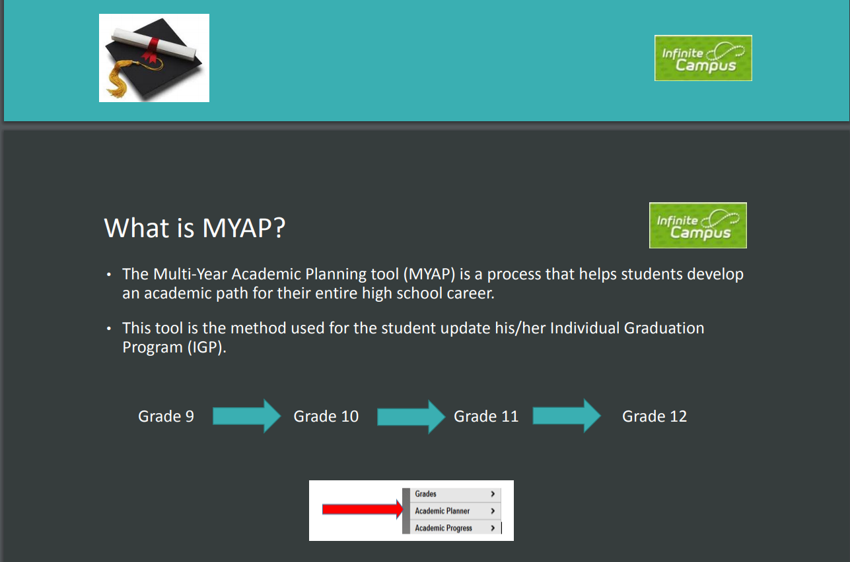
Review all MYAP information in High School 101 and at this link: https://www.paulding.k12.ga.us/Page/34137

Slide 19

Honors and Advanced Placement
Course Information for the CORE Academic and Fine Arts Areas

Slide 20


Why should students take Advanced Placement or Honors classes?
The U.S. Department of Education released a study that shows that by the time students enter college, the type of courses they took in high school is more important than test scores, class rank, or grade averages.
The president of UGA says that rigor of curriculum is a factor above all others that determines success in the college admissions process.

Slide 21
What 9th grade Honors/Advanced Placement classes are available?
Honors 9th Grade Literature/Composition Or 10th Grade Honors World Literature
Honors GSE Algebra I Or Honors GSE Geometry
Honors Biology
Honors World Geography/ AP Human Geography

Slide 22

What do I need to do to get into Honors/AP classes?
During February, your student will complete their Individual Graduation Plan within the Infinite Campus portal using the Multi-Year Academic Planner. Honors as well Advanced Placement courses are considered during this time.
Students will be permitted to make IC course requests for next school year based on the parent-approved BRIDGE Graduation Plan document of courses.

Slide 23
Course | Grade Criteria | Teacher Recommendation | Pre-requisite
Honors 9th Literature | Average Grade in subject of 80 or higher | Considering attendance, homework completion, participation, and student work habits | None
Honors World Literature | Average Grade in subject of 80 or higher | Considering attendance, homework completion, participation, and student work habits | Rising 9th grade students must have completed Honors 9th Literature in 8th grade No prerequisite for current 9th graders
Accelerated Coordinate Algebra/Analytic Geometry A | Average Grade in subject of 80 or higher | Considering attendance, homework completion, participation, and student work habits | None
Honors Analytic Geometry | Average Grade in subject of 80 or higher | Considering attendance, homework completion, participation, and student work habits | Completion of Honors Coordinate Algebra in 8th grade
Honors Biology | Average Grade in subject of 80 or higher | Considering attendance, homework completion, participation, and student work habits | None
Honors World Geography | Average Grade in subject of 80 or higher | Considering attendance, homework completion, participation, and student work habits | None
AP Human Geography | Average Grade in subject of 80 or higher | Considering attendance, homework completion, participation, and student work habits | None
Honors Spanish II | Average Grade in subject of 80 or higher | Considering attendance, homework completion, participation, and student work habits | Rising 9th grade students must have completed Spanish I in 8th grade No prerequisite for current 9th graders

Slide 24

How are Honors/AP classes beneficial to my GPA?
Honors courses are weighted. With successful completion of the course, an average of 70 or above BEFORE weights are added, earns a student five (5) points onto the final course average.
For example: Student earns an 80 in Honors 9th Grade Lit/Comp – the report card and transcript will reflect an 85 as the weighted points are added to the final average.
Advanced Placement courses add 10 points to the final grade, if a 70 or above has been earned.

Slide 25
You and your student MUST
Consider taking honors or AP courses before the BRIDGE Graduation Plan is completed. It is section 2 of this plan along with the signature of student and parent/guardian that authorizes the student to request honors and/or AP courses in Infinite Campus.
Attend the high school informational nights for Honors and AP courses
  The dates and times of these mandated opportunities will be set by each high school.

Slide 26
Pathway/Plan of Study
A student is a pathway completer when he/she concentrates one of these areas:
  CTAE
  Advanced Academic (English, Mathematics, Science, Social Studies)
  World Language
  Fine Arts
  Each student follows the GaDOE Plan of Study along with the BRIDGE Advisement Plan/Individual Graduation Plan in GCIS

Slide 27
Declaration of Pathway/
Plan of Study
8th Grade students declare one Pathway/Plan of Study in one of the following areas:
  Advanced Academic
  World Language
  Fine Arts
  CTAE
Students may also be interested in a second pathway and will use the MYAP tool to plan for those courses.

Slide 28

Advanced Academic
Advanced Academic Plan of Study/Pathway
Some students opt to take rigorous courses in the area of English, Mathematics, Science or Social Studies.
Students are strongly encouraged to select courses in one focused area of interest known as a Plan of Study and to build upon the career interest inventories that they have completed with counselors.
Notes:
28

Slide 29
World Language
World Language-
Some students take a World Language course in the 9th grade or may complete a second world language course, if a world language credit is completed during middle school. Two units in the same World (Foreign Language) is required to be admitted to a four-year college or university. A student may have a World Language Area of Focus in high school by completing 3 sequential World Language Courses
Students are strongly encouraged to select courses in one focused area of interest known as a Plan of Study and to build upon the career interest inventories that they have completed with counselors.
Notes:
29

Slide 30
Fine Arts
Fine Arts-Some students take either a visual or performing arts program as an elective course. Other students may be highly interested in Fine Arts and therefore, want to complete a Fine Arts pathway.
Students are strongly encouraged to select courses in one focused area of interest known as a Plan of Study if the career interest inventories completed as well as the individual student’s career goals support this area of focus.
Notes:
30

Slide 31
Career, Technical and Agricultural Education
CTAE Career Clusters and their Pathways are part of a state supported curriculum that encourages and supports students and families in their educational and career planning through long-term goals, knowledge, experience and resources.
Class of 2027 students will graduate under the IHF6 rule and will be under the 17 Career Clusters for their Pathway courses.
The Career Planner provides complete information about each Pathway offered in our school district.
Notes:
31

Slide 32
Career Clusters and Pathways
CTAE Pathways-Students may earn 3 units of credit in a sequence of CTAE courses in a pathway. These self-selected pathways lead to a college and career readiness certificate. There is a career pathway assessment given at the end of the 3 sequential career pathway courses (usually in the Junior or Senior year).
CTAE Video Link-15 and 40 minute videos
http://www.paulding.k12.ga.us/domain/176
Paulding College and Career Academy
  Great opportunity to complete pathways that are not offered in your own high school building.
Notes:
32

Slide 33
Embedded Course
Essentials of Healthcare, course number 25.44000.
Essentials of Healthcare course meets the fourth science requirement for high school graduation and meets the fourth science requirement for admission to the University System of Georgia and the Technical College System of Georgia.
If one unit of credit is earned in Essentials of Healthcare, then, student will also receive one unit of credit for Human Anatomy and Physiology, course number 26.07300
Both courses count for HOPE
The EC Human Anatomy and Physiology course will be categorized as an Elective on the local high school transcript.

Slide 34
Health and Personal Fitness
Students will participate in the Alcohol and Drug Awareness Program as part of their health course. Students who successfully complete the test given at the end of this program will receive an ADAP card. Teenagers wishing to receive a driver’s license must have an ADAP card.
Personal Fitness and Health are required courses and are worth ½ credit each. Please note: Some students opt to take 3 years/3 credits worth of JROTC to fulfill this graduation requirement.
Notes:
34

Slide 35
Promotion in HS to Next Grade
Students are promoted to the next grade level based on the Cohort Year.
Cohort Year 1 = Grade 9
Cohort Year 2 = Grade 10
Cohort Year 3 = Grade 11
Cohort Year 4 = Grade 12
Then, students must have a minimum of credits earned.
5 Credits (From 9th to 10th grade)
17 credits (From 11th to 12th grade)
11 Credits (From 10th to 11th grade)

Slide 36

End of Course Assessments (EOCs)
English Language Arts
American Literature and Composition
Mathematics
GSE Algebra I
Science
Biology
Social Studies
United States History
Notes:
36

Slide 37
Dual Enrollment Defined
A process by which all 11th & 12th grade (and some 10th) students take courses from a state public or private postsecondary institution while still enrolled as a high school student and receive credit both at the high school and at the postsecondary institution.
Notes:
This is the all encompassing definition of DE that covers all the different type of programs we have that fall under DE.
If students are involved with a program where they are getting credit at both the HS and College levels simultaneously, then it falls under dual enrollment.
Next SLIDE
37

Slide 38
DUAL ENROLLMENT
SB 132 – Dual Enrollment Program
High school students may enroll while in 11TH & 12TH GRADES (10th graders can take CTAE courses at TCSG or can qualify for DE by meeting Zell requirements)
Earn dual credit
Wide range of courses
High School Postsecondary Option (formerly known as SB2)
• Students must complete the following state required high school course requirements (EOC courses plus health and personal fitness):
1 required health and personal fitness course (.5/.5)
2 English
2 math
2 science
2 social studies
Complete an associate degree, technical diploma or two technical certificate programs in a career pathway and all training prerequisites for any state, national, or industry occupational certifications or licenses required to work in the field
Awarded a high school diploma and a college credential(s)

Slide 39
Required Enrollment
Student must be enrolled full-time
This can be done by:
Combination of high school and Dual Enrollment courses
Student must take 4.0 credits worth of courses each semester.
Full time Dual Enrollment student at the college (student must have 12 hours and a minimum of 4 college courses which equals between 12-15+ credit hours)
Travel time or periods off are approved each semester.

Slide 40
Financial Considerations
Tuition is covered for the student.
No mandatory fees for student.
Books are paid for as well.

Slide 41

Dual Enrollment and HOPE and Zell Miller Scholarship
Core courses are included in the student’s HOPE high school GPA for HOPE Scholarship and Zell Miller Scholarship eligibility determinations.
Core coursework taken as dual enrollment meets Academic Rigor requirements and courses are given a weight of 0.5 toward HOPE Calculation. The HOPE GPA calculation has a cap of 4.0.
Core courses are weighted 10 points on the local high school transcript
College transcript begins as Dual Enrollment student.
Dual Enrollment hours do not count against any HOPE hour cap.

Slide 42
Testing and the DE Student
Students must take EOC for these courses: DE Ninth English Lit., DE GSE Algebra I, DE GSE Geometry, and/or DE Biology.
If taking the above EOC courses at the college, the student must come back to the high school to take the EOC.
Counselor should provide the DE students with the EOC test dates.
EOC test is 20% of the EOC course grade only for DE Ninth Grade English Lit, DE GSE Algebra I, and/or DE Biology. The teacher’s grade is 80% of the grade for these three courses.
For the other four EOC courses, the professor’s grade is 100% of the DE course grade. For example, the DE US History course grade is the professor’s grade.
Students must take entrance exams (SAT, ACT, and/or Accuplacer) for the college admission and meet or exceed the required score.
Students must take End-of-Pathway Assessment when completing a pathway.

Slide 43

Things to consider about being a Dual Enrollment Student….
Maturity level of the student
Post-secondary plans of the student
Individual career goals and IGP (Individual Graduation Plan)
Necessary tests for admission to the postsecondary institution(s) of choice
Application and acceptance by the post-secondary institution

Slide 44
More Advisement Topics…
Explain possible impact on future college admission and HOPE eligibility based on the Dual Enrollment program that is chosen.
On-going advisement sessions should be held to update and review individual graduation plan and schedule high school courses accordingly.
Ensure state and local high school requirements for a Dual Enrollment program have been met by the student in order for participation.
Establish a timeline for Dual Enrollment future advisement sessions to determine program status, select courses and complete the Dual Enrollment Applications needed for each semester of participation.

Slide 45
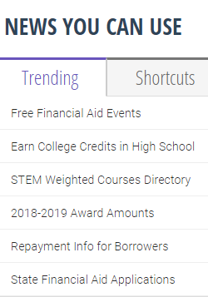

Dual Enrollment Information on GAfutures

Slide 46
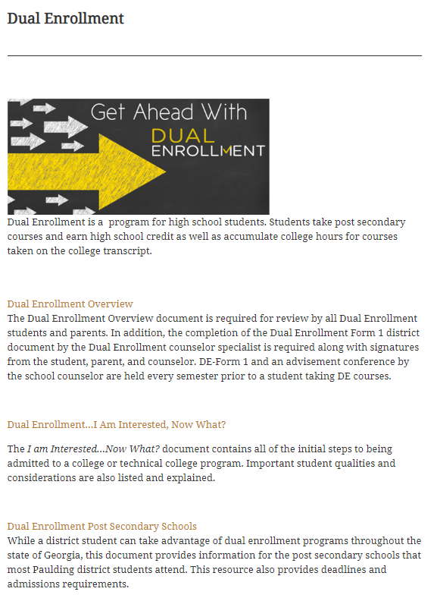
Counseling Website Link with DE Information: https://counseling.paulding.k12.ga.us/index.php/academic/dual-enrollment/

Slide 47
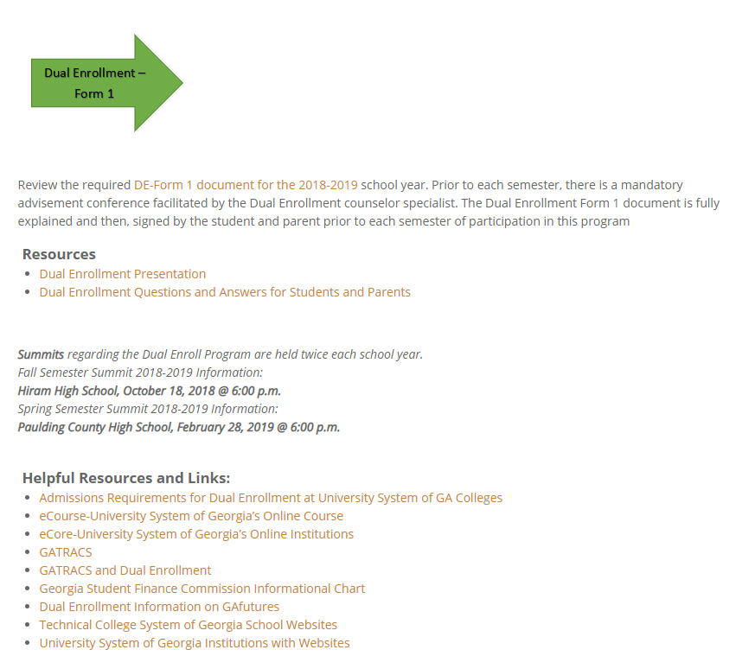
DE Information on the Paulding County Website:

Slide 48

Summits for Dual Enrollment
EVENT: Dual Enrollment Summit
Check the PCSD website for up to date information on when the next DE Summit will be!

Slide 49

Interested students and parents should always contact the school counselor.
There is a Dual Enrollment Specialist/Counselor at each high school.

Slide 50
More things to know about making the transition to high school…

Slide 51
High School 101
- Located on the PCSD Website
- Gives course descriptions & provides in-depth information about High School.

Slide 52

What if your student wanted to take a course Online during high school?
During the months of April – Mid-July there will be a PCSD online registration opportunity for high school courses.
Senate Bill 289 allows Georgia districts to provide students in grades 3 through 12 the option of taking an online course should you choose that option.
Counselors have the online course information for high school courses. The district resource for new credit courses is called Canvas for next school year.

Slide 53

What is the Paulding Virtual Academy?
The Paulding Virtual Academy will offer students the opportunity to use teacher supported, technology-based courses to earn new high school credit, recover credit, continue coursework or accelerate their progression through high school and into college level courses.
The application process for Fall school year begins April 1.
Link for more information: http://www.paulding.k12.ga.us/Page/29099

Slide 54


Slide 55
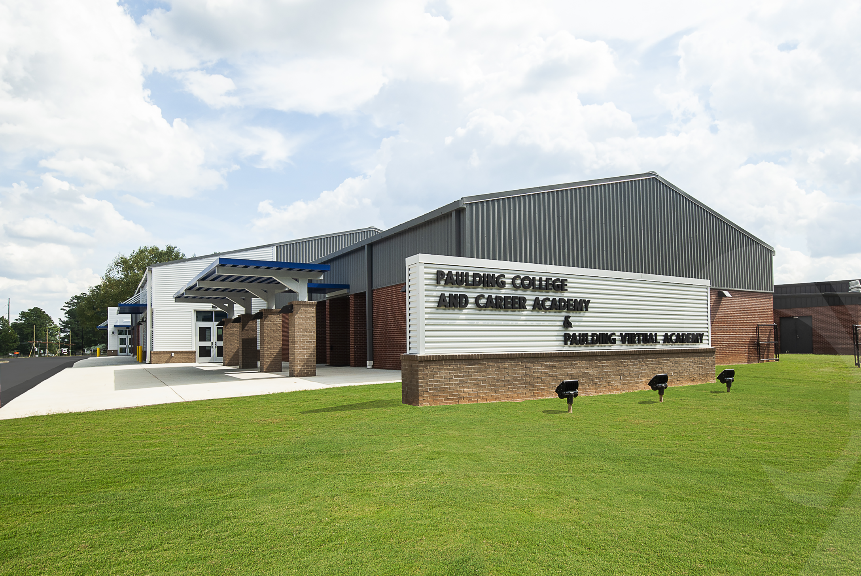

What is the Paulding College and Career Academy?
PCCA opened in the Fall semester of 2019
Students who attend PCCA graduate with a high school diploma plus have:
  Dual Enrollment Course Opportunities
  Work-Based Learning/Apprenticeship Program Courses
  Complete a CTAE Pathway and related courses

Slide 56

What are the Opportunities at the PCCA?

Slide 57

HVACR Electrical Pathway PCCA
Courses (all three) are Dual Enrollment Pathway Courses
Courses are taught at the Bartow County College and Career Academy in Cartersville

Slide 58
PCCA Basics
Requirements:
NONE! You just have to be a high school student in the district and apply for PCCA.
Please talk with your counselor if you are interested as it will impact your schedule.
Applications:
Applications are posted on the district and PCCA website in December.
Transportation:
Students are bussed from their local high school to pcca and then back to the local high school.

Slide 59
TEST-OUT OPPORTUNITIES
Qualified students may test-out in up to 3 EOC courses throughout high school and earn up to 3 high school credits on his/her high school transcript.
Specific information is available and please ask school counselors for that information.

Slide 60
TEST-OUT OPPORTUNITIES
Basic Requirements
1. Limit is 3 courses during high school with a cap of 3 credits earned.
2. PCSD Test-out Registration Opportunity as announced each year. This an Online registration opportunity on the district website.
3. Student cannot have started a course(s) that he/she is planning to test-out.
4. During registration a payment of $50.00 must be made for each test. Students who score Distinguished will have this money reimbursed after scores come back.
5. During February a grade of B or higher will be validated. Also, during February a teacher recommendation regarding the test-out opportunity must be received by the school counselor. This recommendation is completed by the student’s teacher in the subject area.
6. EOCs taken during March.
7. For a student who receives a Distinguished score, the high school transcript is updated with course, grade/score and credit earned.

Slide 61
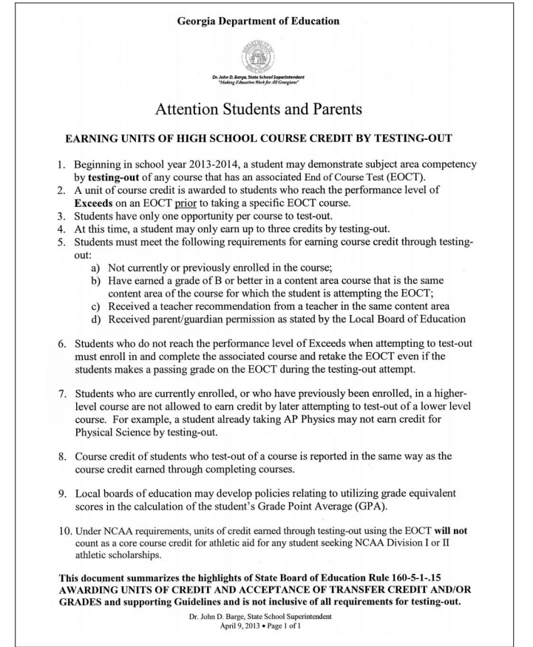
Test-out Opportunities Information
Career Planner

Slide 62

What are the requirements to play sports in high school?
First semester freshmen may participate in sports and extra-curricular activities.
To Keep Eligibility:
  Each student must earn at least 2.5 credits in the previous semester.
    So 9th grade students must have earned 2.5 credits in the fall to participate in the spring..
  Each student must stay “on track” to graduate.
    This means that by the start of the sport you are playing you must have earned the following number of credits:
      10th Grade: 5.0 Credits
      11th Grade: 11.0 Credits
      12th Grade: 17.0

Slide 63
Special Education Students
Special Education students and their parent/guardian participate in all advisement opportunities along with regular education students.
Each special education student’s Individualized Education Plan guides course work and graduation requirements as well as the BRIDGE advisement plan.

Slide 64
What can be expected in high school? (from National Middle School Association)
A larger, more formal, more competitive and grade-oriented environment
Students concerned about grades, getting lost, strict rules and harder work
At the end of the 9th grade year, freshmen described high school as being very different from what they had expected
It is important to be organized, attend school, and work hard to master standards.
Notes:
64

Slide 65
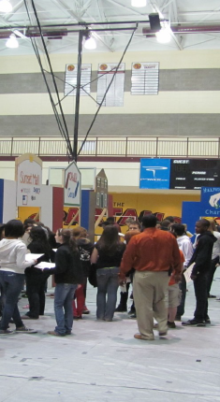
The Reality/Pathway Fair is:
Held at each high school. (usually in October)
An interactive financial tool for middle school 8th grade students.
An experience in REALITY.
Career is selected.
Monthly salary is provided.
Tables are visited for expenses.
A time to learn about the Career Pathways at each high school.

Slide 66

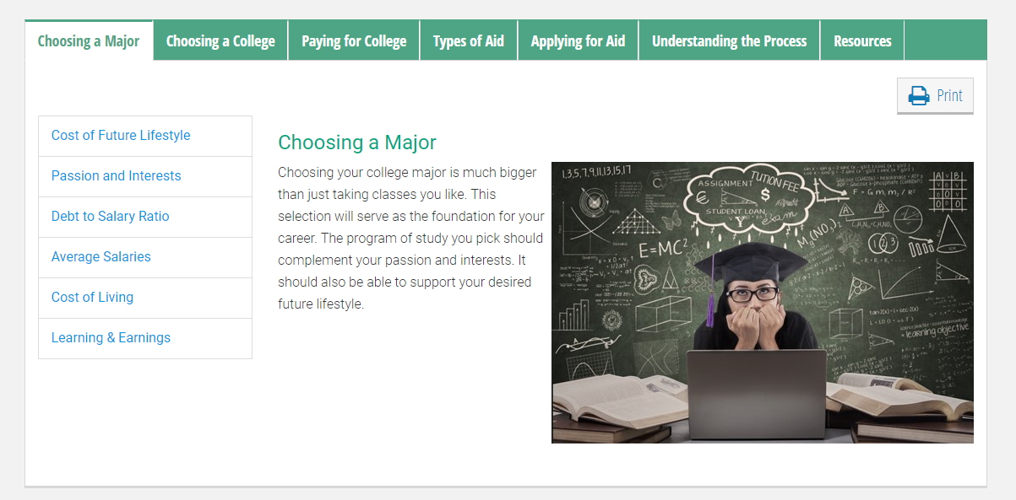
GAfutures has planning tools that include paying for college https://www.gafutures.org/college-planning/college-money-matters/choosing-a-major/

Slide 67
School counselors support all students in three areas:
Academic
Career
Personal/social
Thank you for your time and involvement!
We appreciate you!

